Slide 1
Unlocking Growth: A Comprehensive Business Intelligence Analysis of Transactional Data
This project uncovers insights and opportunities that can contribute to the growth and enhancement of a business

Slide 2




MEET THE CAPE COD TEAM
Kodwo Amissah-Mensah (Team Lead)
Regina Naa Dedei Crabbe
Alvin Momoh
Aliyyah Adebayo Ololade

Slide 3
AGENDA
Overview
Framework
Analysis Approach
The Dataset
Data Analysis
Dashboard Design
Key Findings
Recommendations
Limitations
References
Appreciation

Slide 4
Introduction
Businesses seek meaningful insights in a data-driven environment to make wise decisions and propel success.
This project aims to analyze and derive meaningful information from a comprehensive dataset related to sales transactions.
Various data analysis and visualization techniques were applied to uncover patterns, trends, and valuable insights that can contribute to strategic business decisions.

Slide 5
Project Goal
In this project, our goal is to transform untapped transactional data from the year 2019 into actionable insights that drive sales and operational efficiency for our client.
By leveraging advanced business intelligence solutions, we aim to uncover opportunities and trends within the data to provide strategic recommendations to optimize business processes and maximize revenue.

Slide 6
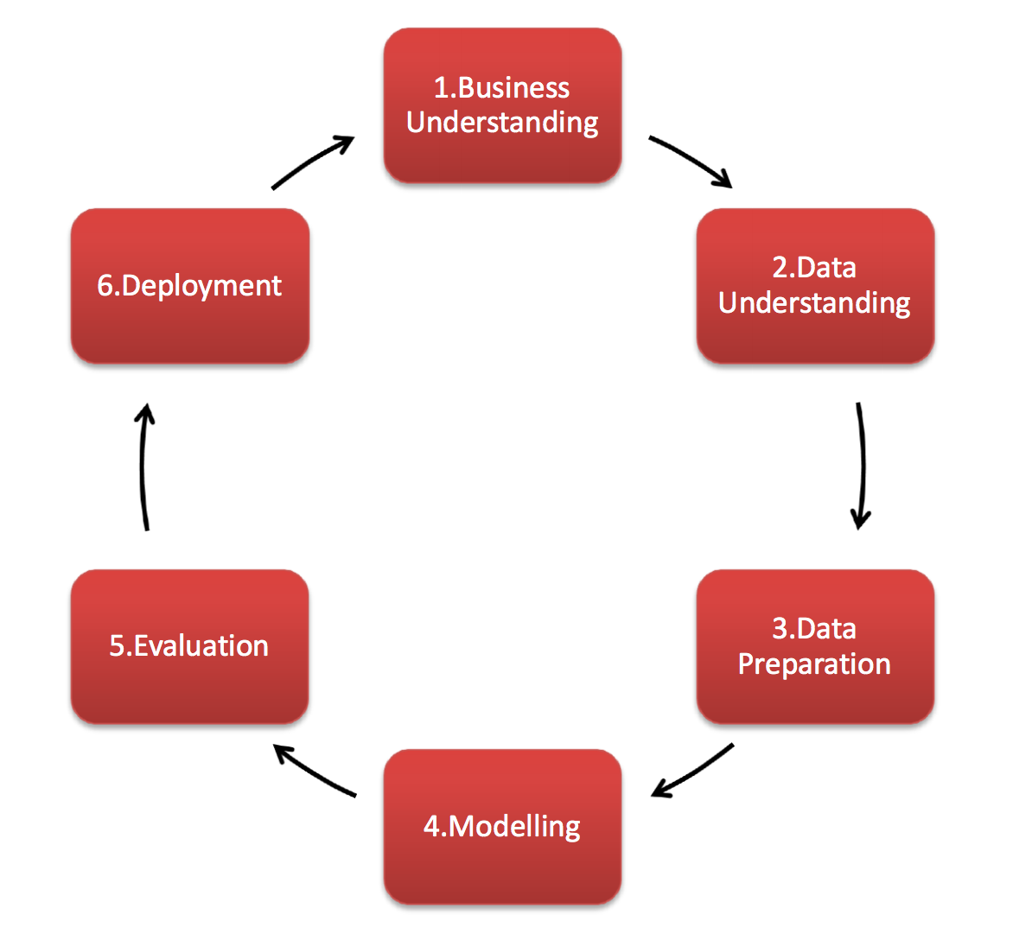
Framework: CRIPS-DM
CRISP-DM stands for cross-industry process for data mining. The CRISP-DM methodology provides a structured approach to planning a data mining project. It is a robust and well-proven methodology.

Slide 7
Analysis Approach
Data Preparation
Data Analysis
Key Findings
Recommendations

Slide 8
Transactional Dataset: Overview
Data Sources:
First six months from OneDrive (January – June)
Next six months from a database (July – December)
Time Span:
All months of the year 2019
Analysis coverage:
01/01/2019 – 01/01/2020
Key Columns:
Order ID: The number that represents customer ID
Product: The type of product
Quantity Ordered: The number of products ordered
Price Each: The price of each product
Order Date: The date the product was ordered
Purchase Address: The address where the product was purchased

Slide 9
Data Preparation
Address Datatype Issues
Handle Missing Values
Isolate City Information.
Rename Columns
Handle Duplicates: Duplicates were preserved because the dataset captures individual transactions, reflecting unique events even when products or customers overlap. This helps us represent purchase patterns and customer behavior, enabling meaningful insights.

Slide 10
Data Analysis

Slide 11
Initial Observations on Dataset
The dataset includes 185,950 orders, providing a comprehensive overview of transactional data.
Quantity Ordered averaging 1.12 units per order indicating that, on average, customers tend to purchase a single item per order. However, there is variability, ranging from a minimum of one unit to a maximum of nine units per order. This suggests diverse customer purchasing behavior, with some opting for single-item transactions and others making larger orders.
The products have an average price of $184.40, with the highest-priced product costing $1,700.
The Order Date spans from January 01, 2019, to January 01, 2020, covering a one-year period.
The standard deviation of product prices is $332.73, highlighting the variability in the prices of the listed products.
Notes:
Total orders was 185, 950
Average unit orders was 1.12 units
This shows that the Average customer tends to purchase single unit Items
The Average product price was $184.40
Highest product price was $1700
The period of data captured was 1 year Jan-1-2019 to jan-1-2020

Slide 12
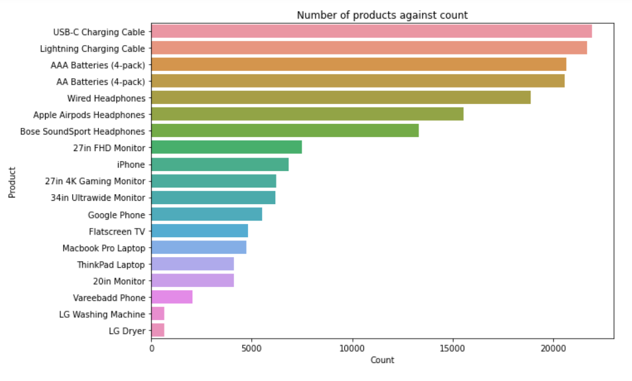
The Order ID and Product Count
Observations
Number of customers is 178,437. This indicates a substantial customer base contributing to the overall sales and transactions.
Number of unique products is 19. This variety suggests a diverse product offering, catering to different needs and preferences.
The USB-C Charging Cable stands out as the most frequently sold product, indicating a high demand for this accessory, possibly due to its compatibility with various devices.
Similar to the USB-C Charging Cable, the Lightning Charging Cable is in high demand, likely due to its compatibility with Apple devices.
AAA and AA Batteries are essential for powering various small electronic devices, explaining their consistently high demand. The continuous demand underscores their importance in everyday electronics usage.
Notes:
Number was 178,437
Shows a large customer base
From our exploration the organization has 19 products
Usb-C charging cable had the highest demand
Follow by lightning charging cable
AAA and AA batteries come third on the chat
Demand is high for these products
Probably because of their usefulness in everyday usage
In small electronic devices

Slide 13
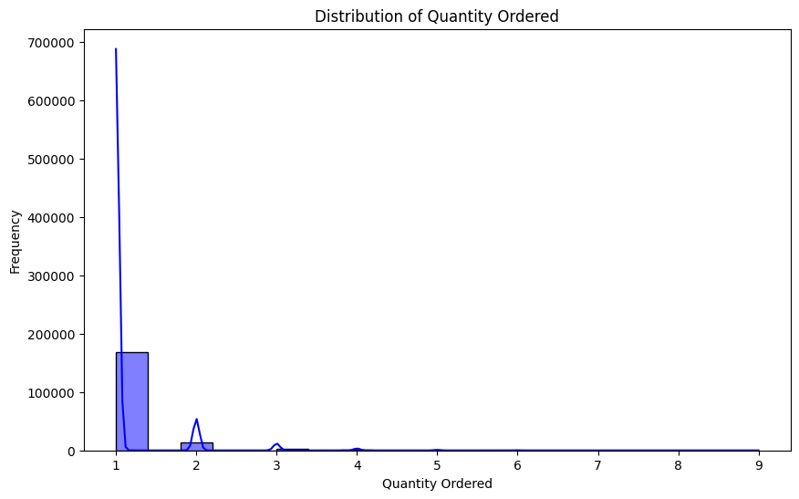
Observations
The total quantity ordered in the dataset is 209,079 units, providing an overview of the overall demand for products.
The majority of orders consist of a single item, with a Quantity Ordered value of 1. This scenario is prevalent, occurring 168,552 times. Single-item orders are a common trend, suggesting that a significant portion of customers tends to purchase individual products rather than multiple items in a single order.
As the quantity ordered increases, the frequency decreases, indicating that larger order quantities are less common.
Notes:
The total quantity ordered was 209,079
Number of single unit product ordered out weighs
Those that are of more than one unit
Out of 207,079 quantity ordered 168552 of them where single orders
To strengthen the previous observation,
On the chat quantity ordered increases
As frequency decreases
Larger order quantity are less common

Slide 14
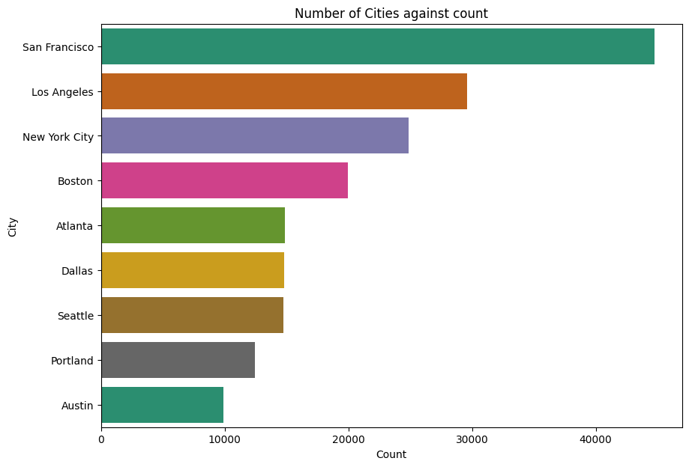
Volume of Transaction Per City
Observations
Transactions cut across nine different cities. This indicates a regional distribution of business activities, with the company serving customers in multiple geographical locations.
San Francisco stands out as the city with the highest transaction count. It has the highest level of business activity among the listed cities, suggesting a strong presence and potentially higher customer demand.
Los Angeles, New York City, and Boston show substantial transaction counts, indicating significant business activity in these metropolitan areas.
Austin has the lowest transaction count suggesting a comparatively lower level of business or customer base in this location.
Notes:
Observed that the company serves customers in multiple
Geographical locations
Because transactions cut across different cities
The city with the highest number of orders was San Francisco
The customer demand in San Francisco tops the chat
Los Angeles, New York city, and Boston
had high order counts too
Austin had the lowest transaction count

Slide 15
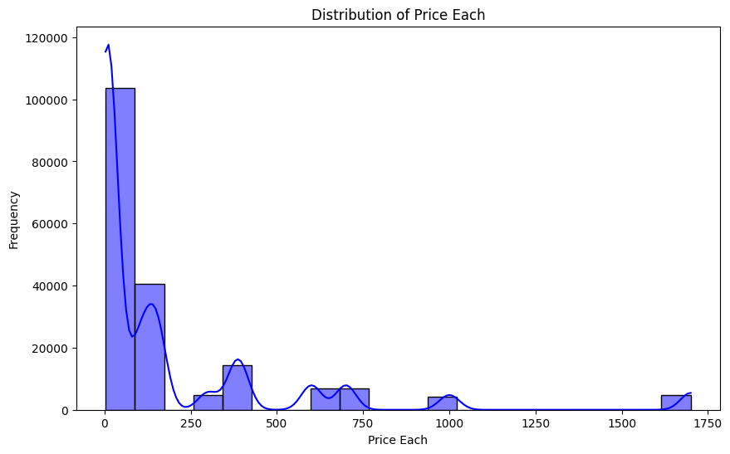
Observations
The most frequently occurring price in the dataset is $150.00. This suggests that products priced at $150.00 are popular or commonly sold items.
Other common prices include $11.95, $14.95, $2.99, and $3.84, with frequencies ranging from 9,385 to 11,260.
There are also higher-priced items like $700.00 and $1,700.00, but they appear less frequently. These higher-priced items may be premium products or larger-ticket items that contribute to a smaller portion of the overall sales volume.
Quantity Ordered Count
Notes:
In terms of frequency
Products priced at $150.00 topped the chat
Other common prices are $14.95, $2.99 and $3.84,
With frequencies ranging from 9385 to 11260
There are also items with high prices like $700 and $1700
But they are less frequent

Slide 16
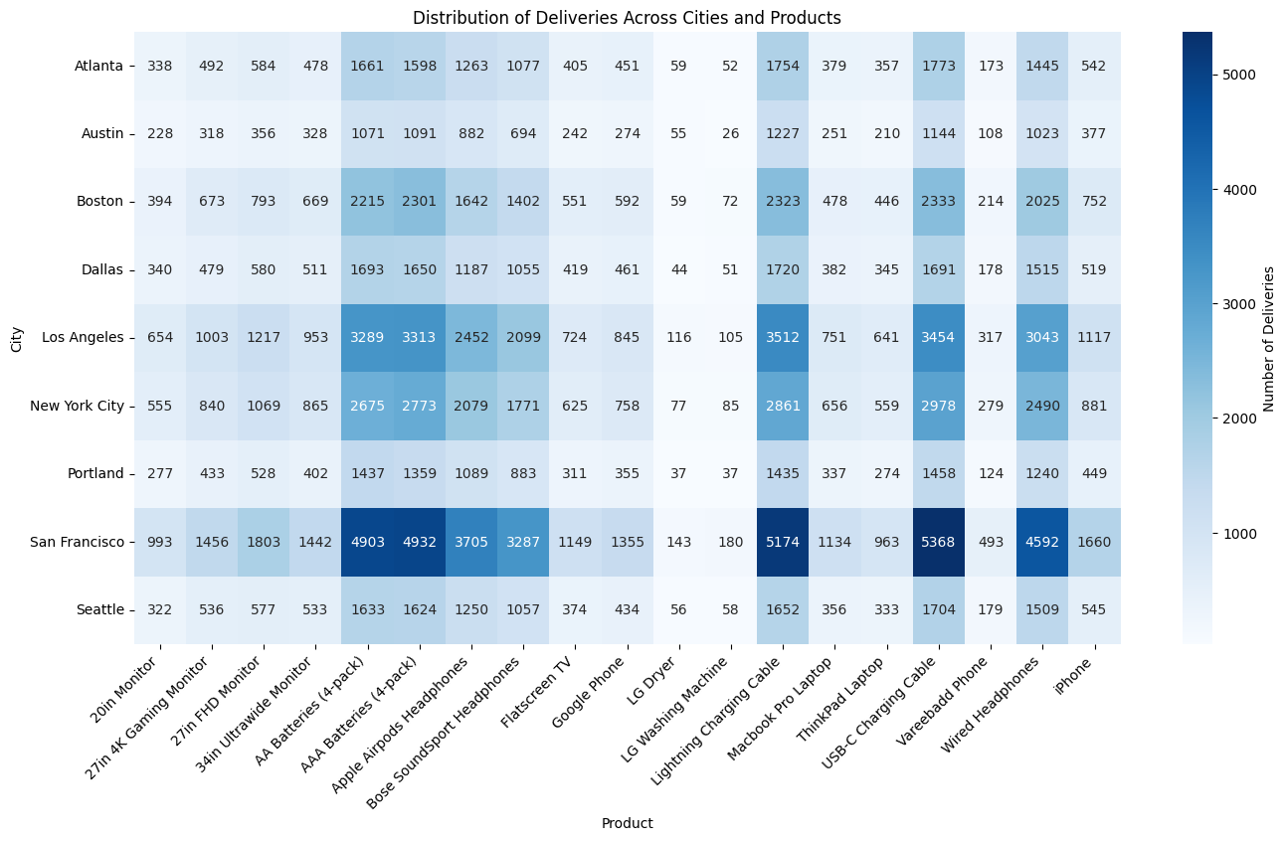
Observations
San Francisco being the city that gives us the highest revenue, has usb-c charging cable being the product with the highest number of deliveries.
San Francisco is known for its tech industry, and USB-C Charging Cables are commonly used with many electronic devices, especially newer laptops and smartphones. The high demand for these cables could be attributed to the city's tech-savvy population.

Slide 17
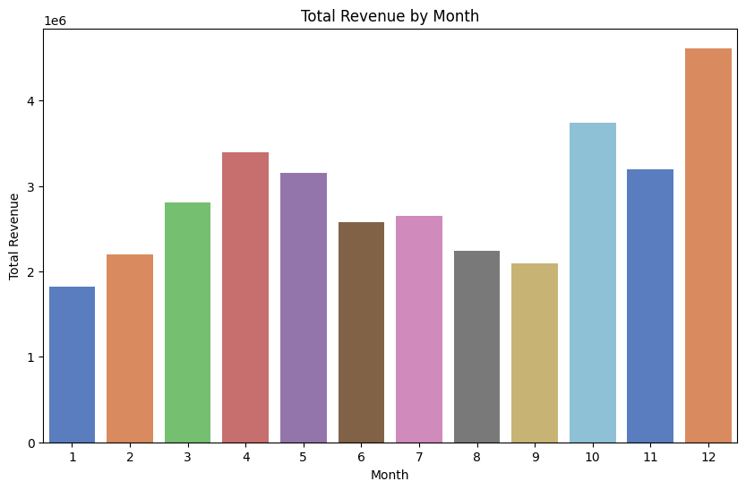
Observations
The month of December gives the highest revenue over the entire year.
The fact that December gives the highest revenue suggests that the business experienced a peak in sales during the holiday season. This aligns with common trends across various industries, as December is traditionally a month of increased consumer spending due to holidays and festivities.

Slide 18
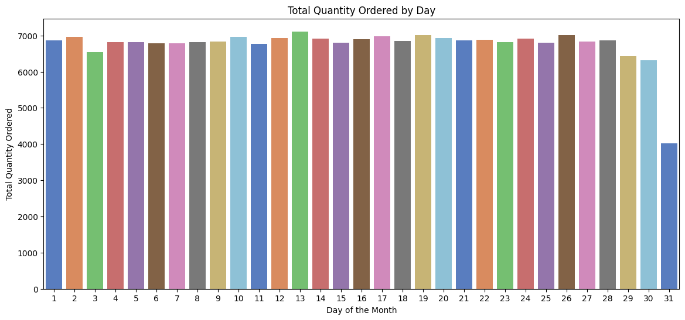
The observed increase in quantity ordered on the 13th of every month suggests a potential impact of promotions or special discounts. Businesses may be running recurring promotions on these specific dates, effectively driving customer engagement and encouraging purchases.
Consideration of local salary cycles around the 13th of each month could explain the surge in orders. Increased purchasing power associated with salary receipt might contribute to higher order volumes during this period.

Slide 19
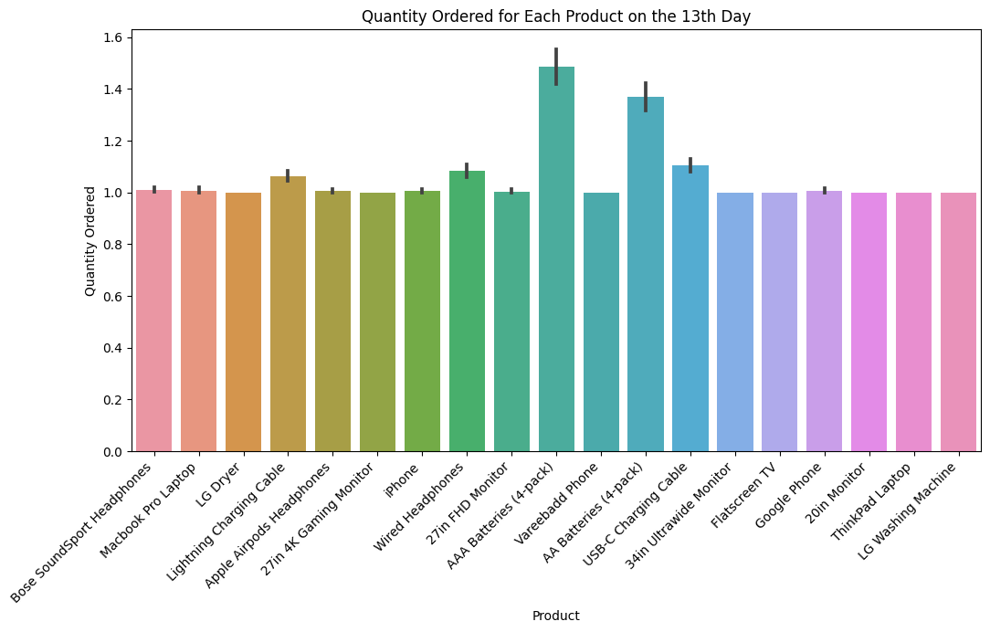
There is an increase in the quantity of AAA batteries ordered on the 13th.
This noticeable increase in the quantity of AAA batteries ordered on the 13th suggests a potential promotional impact on this specific product.
Customers may be responding to promotions, discounts, or special offers specifically targeted at AAA batteries on the 13th of each month.

Slide 20
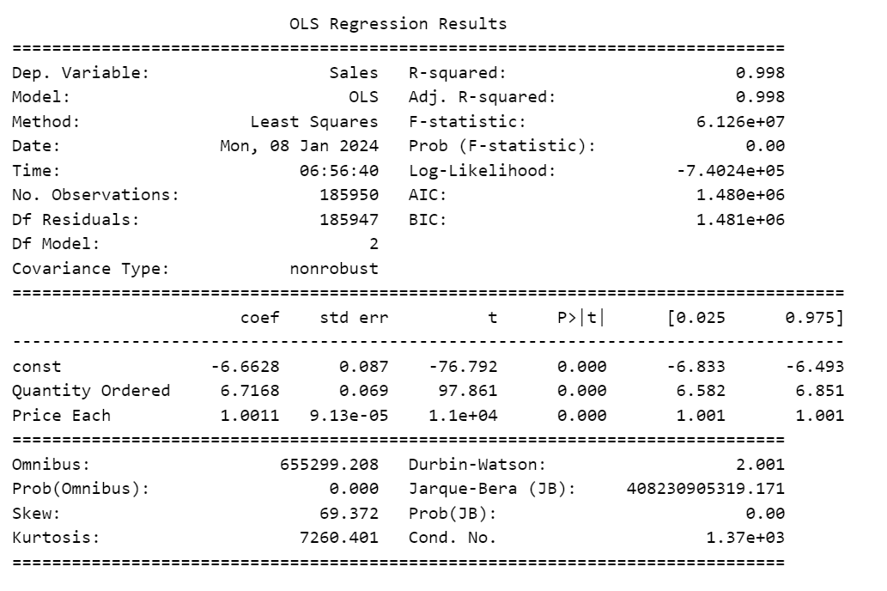
Hypothesis: Quantity Ordered, Price Each have a significant effect on Sales
The model explains a substantial amount of variability in Sales based on the high R-squared value. Approximately 99.8% of the variability in Sales can be accounted for by the model, suggesting a strong fit.
An increase in either the quantity ordered or the price each is associated with higher total sales.
Both Quantity Ordered and Price Each have a statistically significant impact on Sales, as indicated by their low p-values. This means that changes in the quantities ordered and prices each are associated with significant changes in Sales.

Slide 21
Questions
How much money did we make this year?
Can we identify any seasonality in the sales?
What are our best and worst-selling products?
How do sales compare to previous months or weeks?
Which cities are our products delivered to most?
How do product categories compare in revenue generated and quantities ordered?

Slide 22
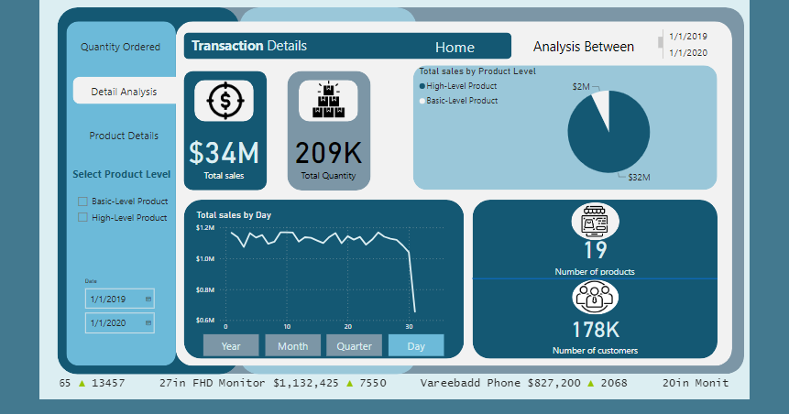
DASHBOARD

Slide 23
Key Findings
The year 2019 witnessed a substantial total revenue of $34,492,035.88, showcasing a robust performance for the business.
Regarding the Product Categories, products categorized as "High-Level" are generating higher revenue compared to the "Basic-Level" category. This indicates that the products within the "High-Level" category, despite potentially having lower quantities ordered, command higher prices or have higher profit margins.
Products categorized as "Basic-Level" are ordered in larger quantities compared to the "High-Level" category. This could imply that customers tend to purchase products from the "Basic-Level" category more frequently, even though each product has a lower price.
Concerning Top Products by Revenue, the top five products contributing the highest revenue were identified as:
MacBook Pro Laptop: $8,037,600
iPhone: $4,794,300
3. ThinkPad Laptop: $4,129,959
4. Google Phone: $3,319,200
5. 27in 4K Gaming Monitor: $2,435,098
These products, characterized by their premium nature and likely higher profit margins, played a crucial role in driving overall business success.

Slide 24
Key Findings
Exploring the best and worst-selling products, AAA Batteries emerged as the best-selling product and LG Dryer and LG Washing Machine were the worst-selling products.
For Sales Trends Over Time, seasonal patterns were observed in sales, with a significant spike during the holiday season in December. Additionally, a noticeable increase in sales on the 13th of each month suggests potential correlations with promotions or customer behavior.
An analysis of sales by cities revealed distinct regional dynamics. San Francisco emerged as a significant contributor to total revenue, reflecting its position with the highest order volumes.
San Francisco not only led in total revenue but also had the highest quantity ordered. This observation aligns with its prominent role in driving overall business performance.
Both "Quantity Ordered" and "Price Each" had statistically significant impacts on sales. The regression model explained a substantial percentage of the variability in sales.
Strategic Implications:
These insights can inform strategic decision-making, guiding inventory management, marketing campaigns, and product development efforts. Understanding customer preferences and capitalizing on high-performing product categories can lead to sustained growth and profitability.

Slide 25
Recommendations
Pricing Strategy: Evaluate the pricing strategy for "High-Level" products to ensure a balance between higher revenue and customer demand. Adjust prices based on market trends and competitor analysis.
Marketing Campaigns: Develop targeted marketing campaigns that highlight the unique features and benefits of both "Basic-Level" and "High-Level" products. Tailor promotional activities to resonate with the preferences of different customer segments.
Top Products Optimization: Given the significant revenue contribution of top products like the MacBook Pro Laptop and iPhone, invest in marketing campaigns that highlight their unique features and value propositions. Consider bundling options or exclusive promotions to further enhance their appeal.
Diversification Opportunities: Explore opportunities to introduce new products within the "High-Level" category to attract a wider range of customers. Consider market research to identify potential high-demand premium products.

Slide 26
Recommendations
Explore opportunities for diversification within the best-selling and worst-selling product categories. For AAA Batteries, consider introducing variations or bundling options to cater to different customer needs. Assess the market for potential improvements or variations of LG Dryer and LG Washing Machine to increase their appeal.
Seasonal Sales Strategies: Leverage the observed seasonal sales trends by implementing targeted marketing strategies during peak months, especially in December. Consider special promotions, discounts, or limited-time offers to maximize customer engagement during these periods.
Regional Focus: Given San Francisco's prominent role in total revenue and quantity ordered, tailor marketing efforts to further strengthen the brand presence in this region. Implement location-specific promotions or events to enhance customer loyalty and attract new customers.

Slide 27
Recommendations
Inventory Optimization: Focus on maintaining optimal inventory levels for "Basic-Level" products to meet customer demand. Implement data-driven inventory management strategies to prevent stockouts and overstock situations.
Customer Engagement: Engage with customers on the 13th of each month by implementing targeted promotions or exclusive deals. This could be tied to a loyalty program or special events, creating a sense of excitement around these dates.
Continuous Monitoring and Adaptation: Establish a system for continuous monitoring of sales trends, product performance, and customer preferences. Regularly reassess the market landscape, incorporating new data and insights to adapt strategies and stay responsive to evolving consumer behavior.

Slide 28
Limitations
The dataset lacks certain features like customer demographics and economic indicators that could offer valuable insights into the factors influencing sales.
The dataset spans from January 1, 2019, to January 1, 2020. A one-year time frame may not capture long-term trends, and insights derived from this period may not be fully representative of the business's overall performance.
The dataset categorizes products into "High-Level" and "Basic-Level." A more detailed product categorization could offer insights into the performance of specific product types or product groups.
Seasonal factors influencing sales might not be fully captured in the dataset. External factors such as economic conditions, industry trends, or global events could also impact sales but are not explicitly considered.

Slide 29
References
Bharadiya, J. P. (2023). Machine learning and AI in business intelligence: Trends and opportunities. International Journal of Computer (IJC), 48(1), 123-134.
Salgado, B. A. F. (2023). Unlocking Performance Potential: Power BI Implementation and its Transformative Impact on Proef's Business Intelligence.

Slide 30
Appreciation
The team expresses its gratitude to Azubi Africa for the invaluable knowledge imparted over the past nine months. A special acknowledgment goes to the instructors for their dedication. As this program concludes, we anticipate continuing this journey and aspire to achieve even greater heights

